Slide 1
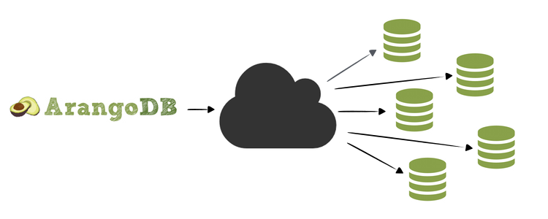
Multi-Model Knowledge Graph using ArangoDB with Wikidata

Slide 2
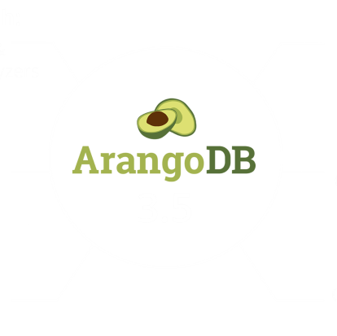
Introduction
Knowledge graph represents a network of real-world entities and illustrates the relationship between them. ArangoDB is a modern, open-source NoSQL database supporting multiple data models. Wikidata as a collaborative knowledge base with structured data. purpose of the project: Create a knowledge graph representing relationships between entities.

Slide 3
Objective
Using ArangoDB to create Multi Model Knowledge Graph of large datasets
Extracting data from Wikidata
Load Wikidata into ArangoDB
Create Entity Graph
Utilize AQL for Graph Queries Find Instances of a Entity Type

Slide 4
Background:
What is a MMD:
Multi-model database is a type of database management system that supports multiple data models within a single database.
Wikidata's Structure:
Wikidata uses the entity-attribute-value (EAV) model to store data
leading to data inconsistency and difficulties in maintaining data integrity.
Attributes are stored as key-value pairs associated with the QID.
Need For Multi Model Knowledge Graph:
Have the ability to incorporate diverse data types and models.
integration of different data models in a single database.

Slide 5

Multi-model knowledge graph and it's uses:
1
knowledge graph that combines data from multiple sources or domains, enabling the integration of various types of information
2
Traditional knowledge graphs that focus on a specific domain or data type.
3
It makes working with large datasets simpler by structured data curation.

Slide 6
Benefits of ArangoDB:
Multi-Model: ArangoDB supports multiple data models (document, graph, key-value) in one database.
It offers fast data access, efficient disk I/O, and scalability
Allows complex queries across different data models.

Slide 7
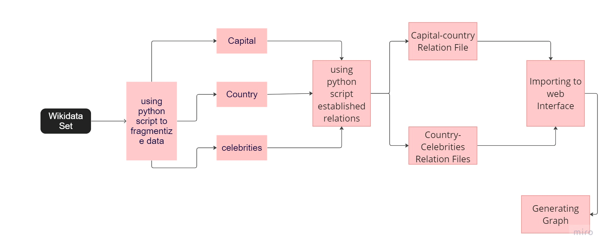
Methodology

Slide 8

Methodology
Step-by-Step methodology for the project:
Download and install ArangoDB server
Obtain the latest Wikidata dump in JSON format
Create a database and collection in ArangoDB for storing Wikidata
Load the Wikidata JSON into ArangoDB using import tools or programmatically
Define a graph schema representing entity relationships
Create a graph in ArangoDB based on the Wikidata collection and schema
Use AQL to query the graph and find instances of specific entity types
Analyze and visualize the query results for insights

Slide 9
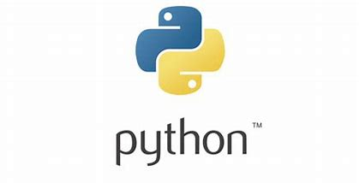


Installation

Slide 10

Data Collection
Process of collecting data from Wikidata:
Downloading the desired Wikidata dump file (JSON format) Parsing the dump file using tools or scripts to extract relevant information Structured data format with entities, properties, and values Optionally, mention the use of SPARQL queries for data collection
Data extraction using SPARQL:
using SPARQL queries to extract dataset from the wikidump.

Slide 11
Package Installation
Provide instructions for installing the pyArango package for Python:
Use pip to install the package
Import necessary modules for establishing a connection to ArangoDB
Configure the connection with host, port, username, and password

Slide 12
Data Import
Present the steps for importing data into ArangoDB:
Prepare data in a suitable format (JSON, CSV, RDF)
Create collections in ArangoDB for entities and relations
Transform and map data to match the collection schema needed
Import data using ArangoDB's import tools or programmatically insert documents
Optionally, provide example code for importing entities and relations

Slide 13
Entity Results Generation
Show an example code snippet for generating entity results:
Loading entities from a JSON file
Separating entities into categories (countries, cities, celebrities)
Saving each category to a separate JSON file

Slide 14
Entity Relation Generation
Display an example code snippet for generating entity relations:
Loading query results from a JSON file
Creating sets to store added names in each file
Creating lists to store country-capital and capital-celebrity relations
Iterating through query results and adding relations if not already added
Saving the relations to separate JSON files

Slide 15
Graph Creation
Explain the process of creating a graph in ArangoDB:
Defining vertex collections for entities (countries, cities, celebrities)
Defining edge collections for relationships between entities
Creating a graph using the defined vertex and edge collections

Slide 16
Conclusion
Summarize the project and its key outcomes:
Created a multi-model knowledge graph using ArangoDB and Wikidata
Established relationships between entities for enhanced data exploration
Demonstrated the power of graph databases in representing complex relationships
Potential applications in various domains like recommendation systems, knowledge discovery, etc

Slide 17
Q&A
Open up the floor for questions and discussions

Slide 18


Thank you

